Slide 1

MIRPUR UNIVERSITY OF SCIENCE AND TECHNOLOGY (MUST), MIRPUR DEPARMENT OF COMPUTER SCIENCE & INFORMATION TECHNOLOGY

Slide 2
Professional Practices Lecture [4] : Case Studies
Dr. Anum Tariq
(Lecturer)
Date: April 23, 2020

Slide 3

Today’s Agenda
We will discuss following case studies:
Case study 1) Copy and Paste...
Basis for Case Study 1
Pakistan Law for copyright protection
HEC plagiarism policy

Slide 4
Basic For Case Study 1-
There are many examples of alleged plagiarism. Harvard undergraduate author, Ms. Kaavya Viswanathan was accused of plagiarism and copyright infringement. The resulting publicity uncovered multiple offenses and ultimately led to the withdrawal of her first novel from the market by her publisher, Little Brown & Company.
Reference:
Zhou, David. (2006) Harvard Crimson. April 23. "Student's Novel Faces Plagiarism Controversy.” http://www.thecrimson.com/article.aspx?ref=512948

Slide 5
Basic For Case Study 1-
Students aren't the only ones who commit plagiarism. In 2000 a college student doing research on the internet discovered marked similarities between speeches given by two college presidents, one speech having been delivered more than ten years earlier. The alleged plagiarist ultimately acknowledged the close similarities between the speeches but argued that someone else had prepared his speech for him. Interestingly, the same individual came under fire subsequently for alleged plagiarism.
Reference:
J. Basinger. (2000) Chronicle of Higher Education. May 19. "The Similarities of 2 Presidents' Papers." http://chronicle.com/weekly/v46/i37/37a05001.htm

Slide 6
Case Study 1-
Late in the afternoon, Lisa finally had a chance to Google for information on "problem-based learning" for her course assignment due the next morning. Though she was tired, she couldn't help but wonder when she noticed the same article appearing on the first two websites was almost identical word-for-word. Both websites were for education courses being taught by two different faculty at two different academic institutions located in different states. Curious, she emailed the authors of both papers concerning her observation and printed out a copy of both pages to bring with her to class the next morning.

Slide 7
Case Study 1-
Consider each of the following questions and evaluate the case study:
What is the action or inaction that is the cause for concern?
Who or what may be affected?
How will they be affected? (i.e., what are the possible consequences?)
Are there any laws, regulations written or unwritten that may apply?
What actions might be taken and what would the consequences of these actions be?
Can anything be done to prevent this from reoccurring or to minimize the severity of the consequences?

Slide 8
Basic For Case Study 1-
Consider each of the following questions and evaluate the case study:
What is the action or inaction that is the cause for concern?
The cause for concern is that Lisa believes she has discovered a case of plagiarism involving a webpage for a course.
Who or what may be affected?
The professor whose work has been plagiarized has been affected and of course, the alleged plagiarist. The college or university where the plagiarist is employed may also be affected by the alleged plagiarist's actions.
How will they be affected? (i.e., what are the possible consequences?)
It is difficult to gauge the significance of the alleged plagiarism. Certainly, the alleged victim has not received credit for his/her work. The college or university where the alleged plagiarist is employed may receive negative press and their reputation may be negatively impacted as a result of the plagiarist's actions.

Slide 9
Basic For Case Study 1-
Consider each of the following questions and evaluate the case study:
Are there any laws, regulations written or unwritten that may apply?
Yes, any printed material that you post on a webpage is automatically protected by U.S. copyright.
check pakistan policies (law) related to copywrite:
http://www.pakistanlaw.com/copysoft.htm
What actions might be taken and what would the consequences of these actions be?
Certainly universities and colleges take plagiarism and other acts of professional misconduct by faculty very seriously. Depending on the rank and tenure-status of the alleged plagiarist, he/she might be censured or could even be fired if it indeed turns out that he/she plagiarized the webpage.

Slide 10
Basic For Case Study 1-
Consider each of the following questions and evaluate the case study:
Can anything be done to prevent this from reoccurring or to minimize the severity of the consequences?
Aside from education, it appears that there is little that can be done to prevent plagiarism. Certainly by the time one becomes a degreed professional, you are expected to know what plagiarism is. It is for this reason that the consequences of plagiarism are so severe.
Check HEC plagiarism policy …...

Slide 11
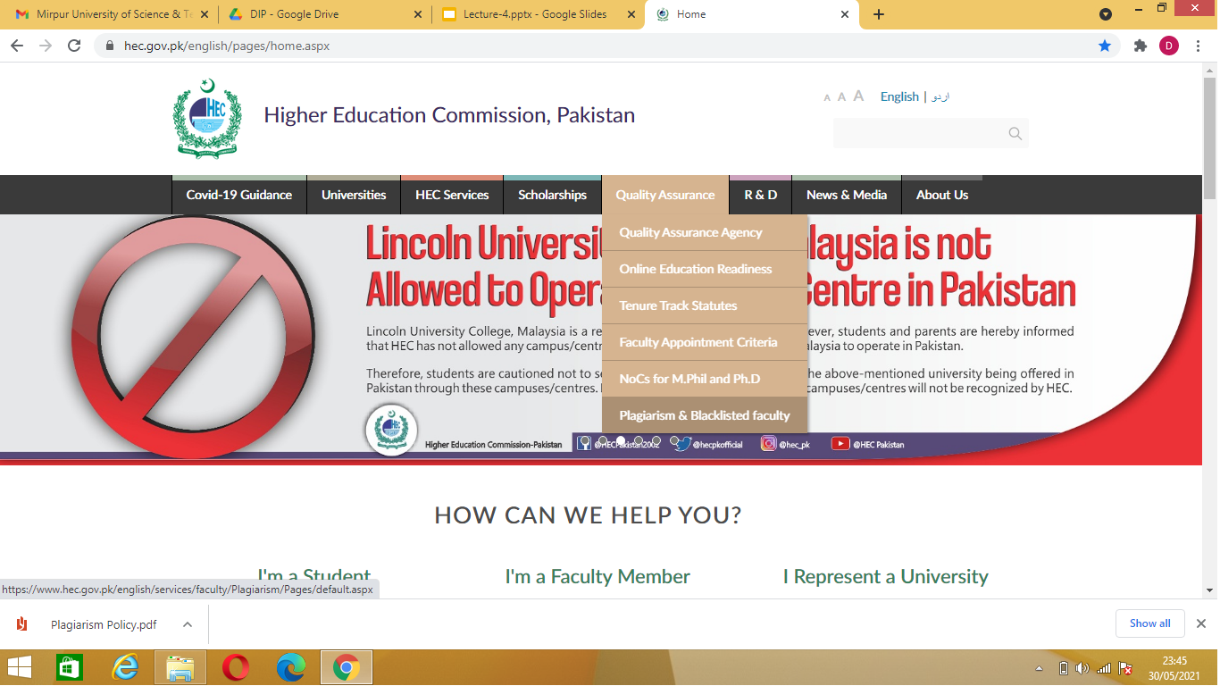

Slide 12
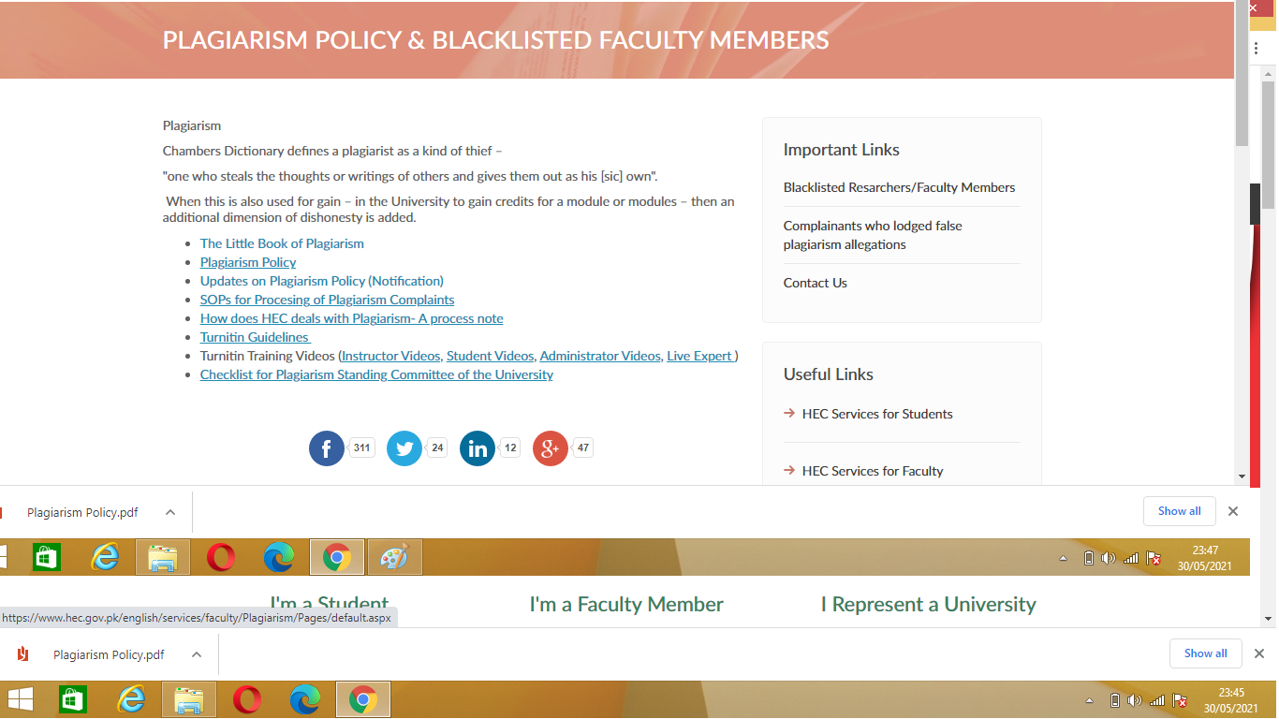

Slide 13
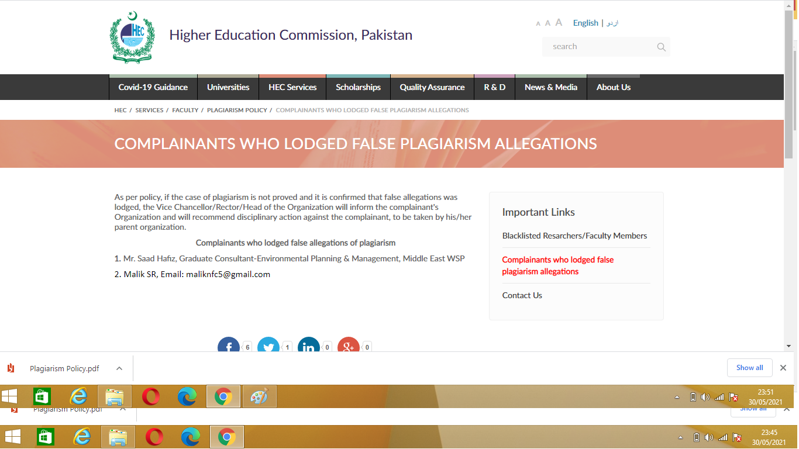

Slide 14
References
Webguru.neu.edu. 2020. Copy And Paste... | Webguru. [online] Available at: <http://www.webguru.neu.edu/professionalism/case-studies/copy-and-paste> [Accessed 3 May 2020].

Slide 15
THANKS

